Slide 1
Get Psyched Up for AP Exam

Slide 2
Get Psyched Up for AP Exam 2021!
Wow, it is already here! And we will be ready for the AP PSYCHOLOGY Exam!
Let’s do a quick review of what’s going to happen and what we should do !

Slide 3
Test Break-Down
Section I: 100 multiple choice questions (70 minutes)
This section is 66 2/3% of the score.
Section II: 2 essay questions (50 minutes)
This section is 33 1/3% of the score

Slide 4
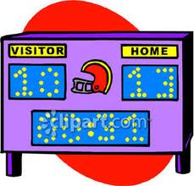
Scoring
Multiple Choice = # correct (do not leave any answers blank)
Free Response = These are graded each June by readers from universities and high schools.
They use a set scale to grade the writings, and they basically check off each element as it occurs.
They are each worth 25 points, but you are answering usually 7 points per question.

Slide 5
Strategies- Multiple Choice
Keep a cool head.
Remember the AP Exam is not like a regular quiz or test, when you have to do almost perfectly to get an A.
If you get roughly 70% of the multiple-choice questions and get a 5 or 6 out of 7 on the free responses, then you can get a 5.
So, if you are finding every fourth question to be hard, then you still could be doing well.

Slide 6
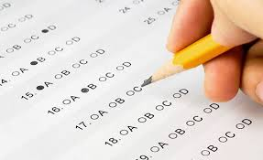
Strategies- Multiple Choice
Answer all questions!
A great deal of the terms used in Psychology are common-sense.
Even though you don’t recognize ‘cognitive dissonance’, for example, you can generally infer from the name what is meant.
10 to 12 questions on the test, you will not have seen anywhere in the text, or the course possibly.
RATIONALE?
Someone who does exceptionally well on the test should be able to assimilate information together.
They have the background knowledge for, and they also have researched beyond the demands of the class. (i.e. an aspiring Psych major)
DO NOT FREAK OUT! If all else fails…make an educated guess

Slide 7
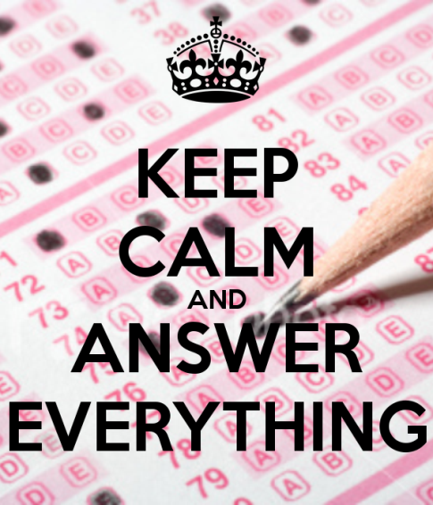
Strategies- Multiple Choice
Remember, the questions increase in difficulty.
PACE YOURSELF!!
Know your TERMS AND VOCABULARY!!! Some of the terminology may be more clinical or simply different than the wording you’ve been using in class or in your textbook. Try to reason it out and be aware of multiple names for certain concepts.

Slide 8
Strategies- Multiple Choice
Know your psychological perspectives REALLY WELL!!!
In many cases, even if you aren’t sure of an exact answer, you can use info you DO know to figure it out.
Many questions can be answered (or at least answer choices can be eliminated) by understanding the major psychological perspectives VERY well. (Ex: If the questions is about Behaviorism, the answer is NOT Freud!!)

Slide 9
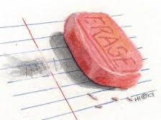
Strategies- Multiple Choice
Do not leave any questions blank. Remember, they have gotten rid of the guessing penalty, any questions you get right by accident helps your score. ☺
Make sure you are bubbling in the correct bubbles for the question you are answering!! Make sure the questions and answer #s match up!!!
ERASE COMPLETELY. Unlike in class,
no one can “fix” or “correct” your erasing
issues. This is extremely common in class!
Do not let this happen during the real exam!

Slide 10
Strategies- Multiple Choice
Breakdown the questions and know exactly what they are asking. Do not simply blow through the question; make sure you don’t make any mindless mistakes due to lake of attention in the question…. Some of the easiest questions may be trickier than they seem.
Use Process of Elimination!
Get rid of answers you KNOW are wrong
and then figure the answer out from
the remaining choices.
CANNOT skip anymore!!
(There is no longer no penalty for skipping questions.)

Slide 11
Which of the following is a type of therapy for alcoholism that involves the administration of a drug that will induce nausea after the person consumes alcohol? A) aversion B) implosive C) flooding D) instrumental E) rational-emotive behavior

